Slide 1
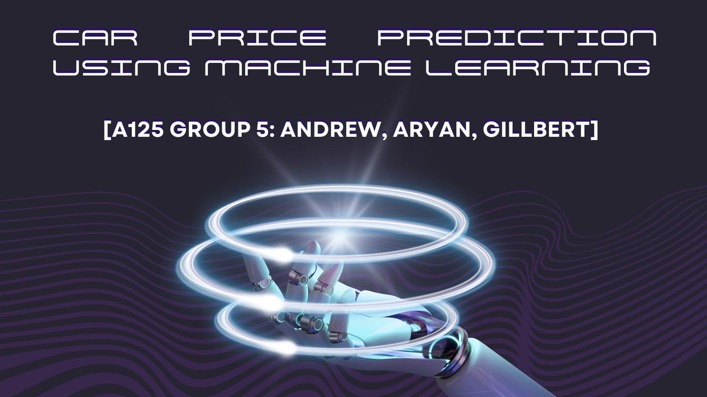

Slide 2



OUR TEAM
Andrew
Aryan
Gillbert
Data cleaning, EDA and slides
Data Extraction & preparation, Documentation
Pipeline, Feature Engineering, Model training

Slide 3
Problem Formulation
Practical Motivation:
In Singapore, new car registration -> expensive
We want to improve the market for used cars in SG

Slide 4
Problem Formulation
Investigative Questions:
Based on automobile characteristics:
- How should a buyer decide if a used car is worth buying?
- How much should a seller price his car to get it sold?

Slide 5
Problem Definition
Which features of automobiles are necessary to achieve an efficient market and justify its associative prices?

Slide 6
Problem Formulation
USA
Large population of Car users
Robust economy
Notes:
We chose a USA dataset because they have similarities to singapore and have a large dataset of used car prices due to larger population

Slide 7
US used Cars Dataset
Variables
Prediction Problem
The Dataset has 66 variables which describe a car
Price prediction of a car - Regression Problem
Relevance to Problem
Obtained from
Obtained in 2020
We obtained this Dataset from Kaggle

Slide 8
Data preparation and cleaning
Notes:
ANDREW TO SPEAK FROM HERE

Slide 9
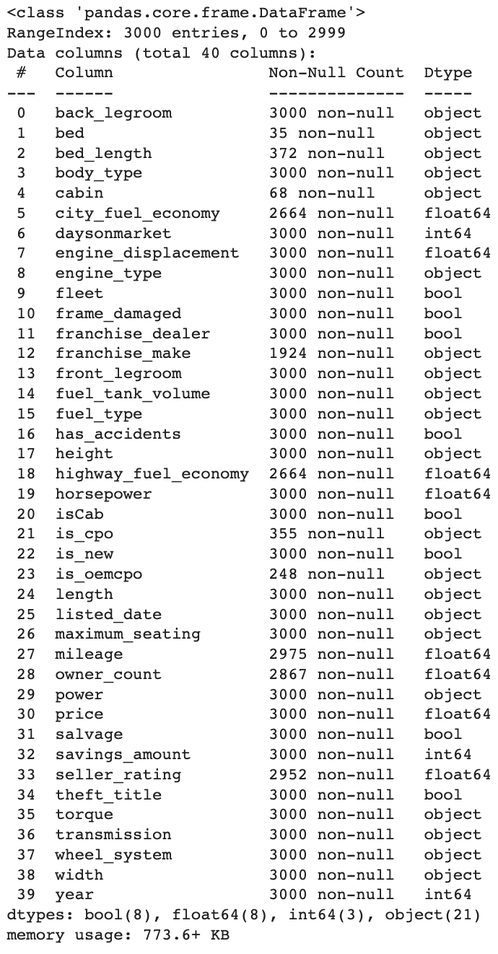
Variables in Dataset
Drop 26 of the variables and keep 40

Slide 10
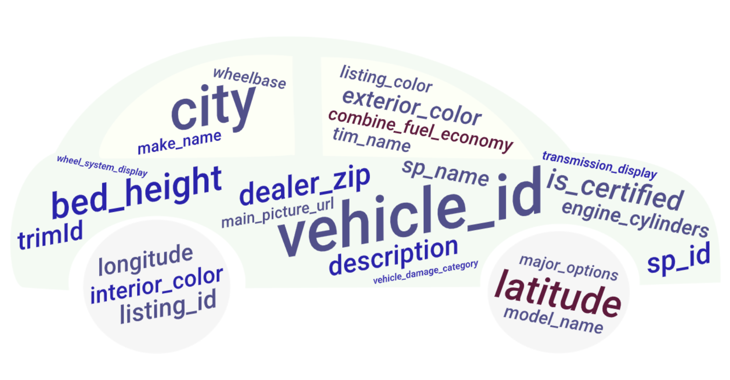

Slide 11
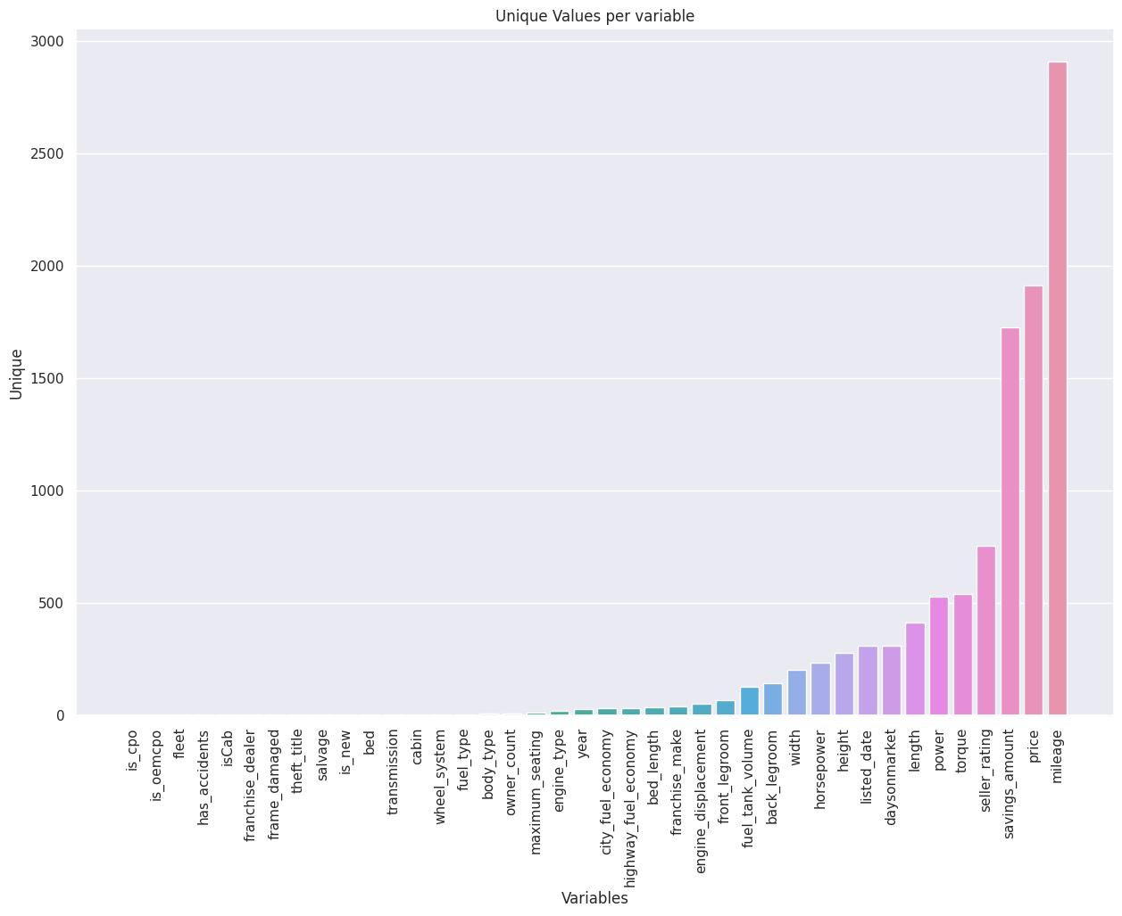
Preliminary Exploration

Slide 12
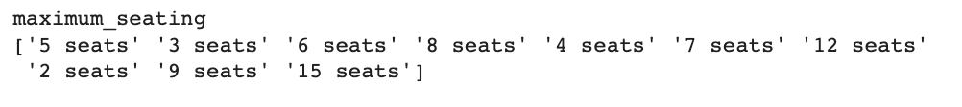
Data Preparation & Cleaning
Converting String values to Numerical values, filling in null values with mean thereafter

Slide 13
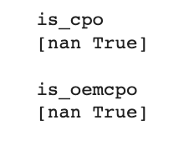
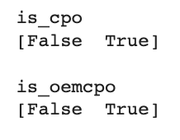
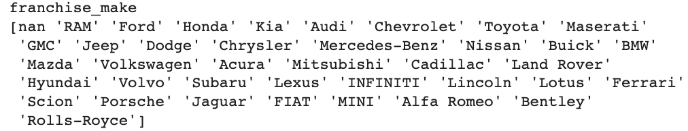
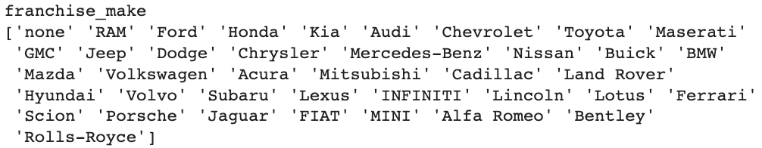
Data Preparation & Cleaning
Filling null Categorical values with the appropriate value

Slide 14
Data Preparation & Cleaning
Feature Engineering of values
Listed Date
TorqueRPM
carAge
Year
Torque
RPM

Slide 15
Exploratory Data Analysis
Notes:
ANDREW TO SPEAK FROM HERE

Slide 16
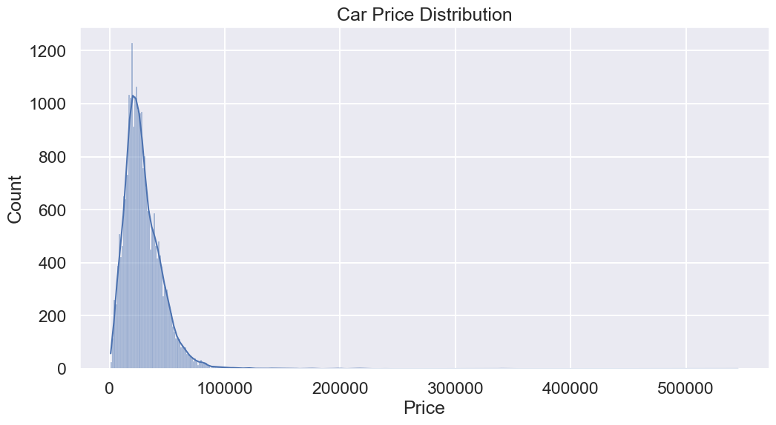
Exploratory Data Analysis
30,000 samples
Mean | $29,439
Stdev | $19,203
25% | $17,991
50% | $25,986
75% | $37,765
Notes:
GILLBERT TO SPEAK FROM HERE
Thanks Aryan. Now, let’s explore some interesting variables in our dataset, which we explored after cleaning our data. First, let’s take a look at the distribution of car price, which we’re trying to predict. So, 50% of cars are priced between 18k usd and 38k usd and on avg, cars are priced around 29k usd. The distribution has a positive skew which shows that there are very few expensive cars (>38k usd). So, let’s take a closer look at the 3 cheapest and most expensive cars.

Slide 17
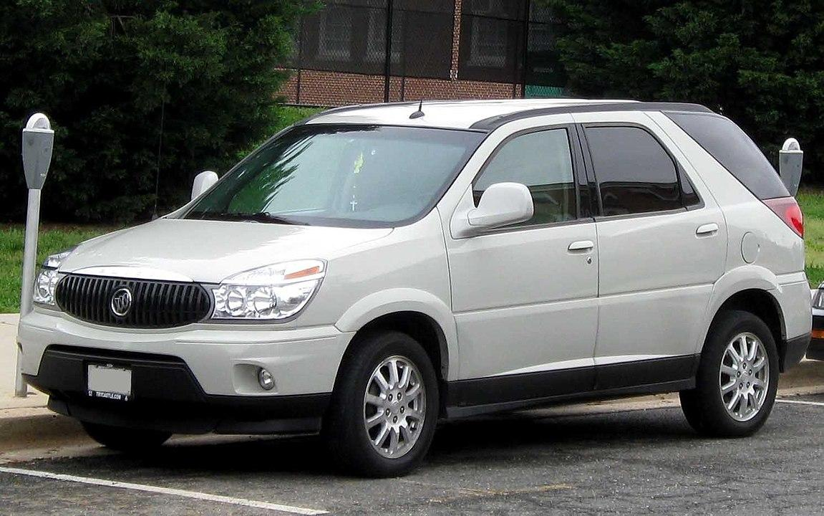
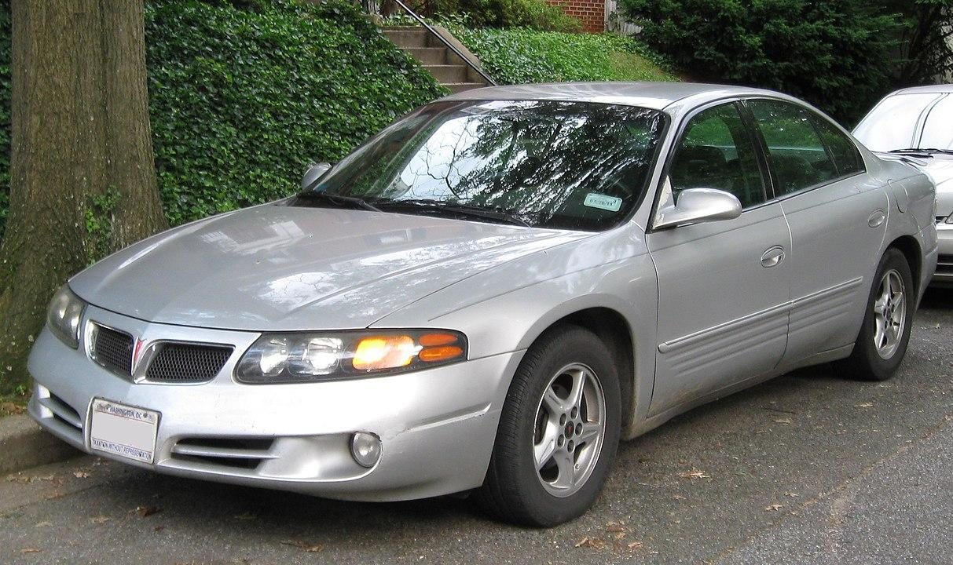
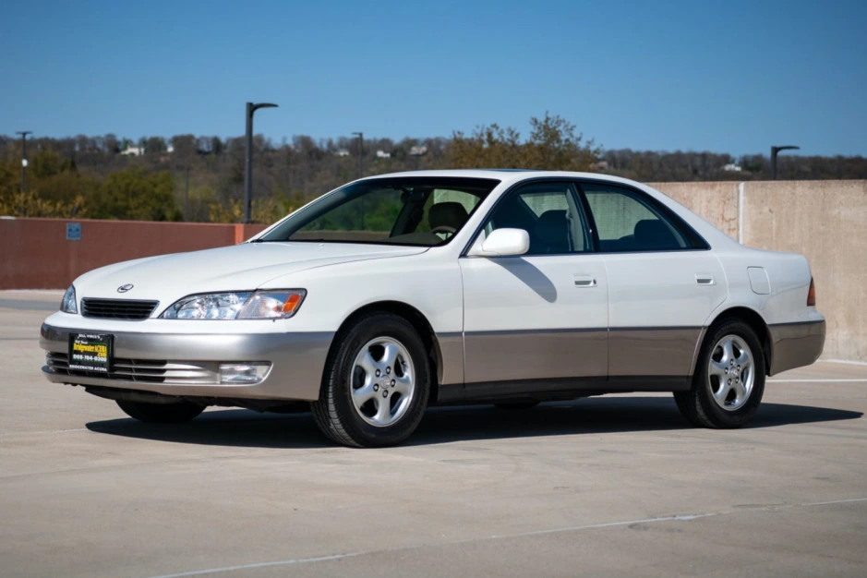
3 Cheapest Used Cars
Buick Rendezvous (2003)
Pontiac Bonneville (2000)
Lexus ES300 (1999)
Body Type | SUV | Sedan | Sedan
Engine Type | V6 | V6 | V6
Horsepower | 185 | 205 | 210
Price | $900 | $900 | $995
Notes:
For the 3 cheapest cars, they are relatively old (released around 2000), as the dataset was taken in 2020. Their horsepower is also quite low (around 200) and their engine type is all V6.

Slide 18
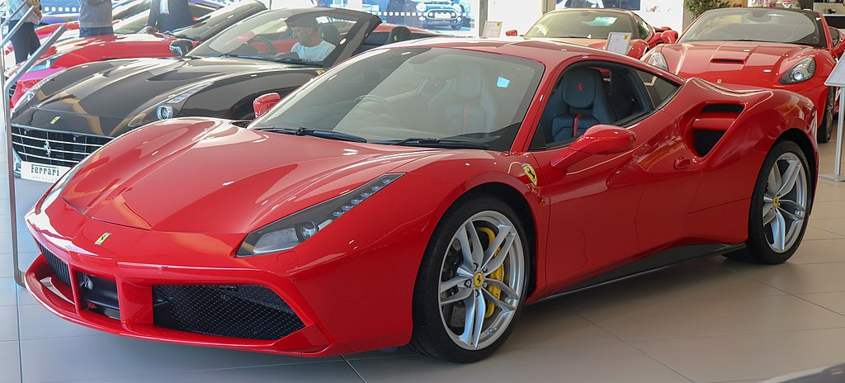
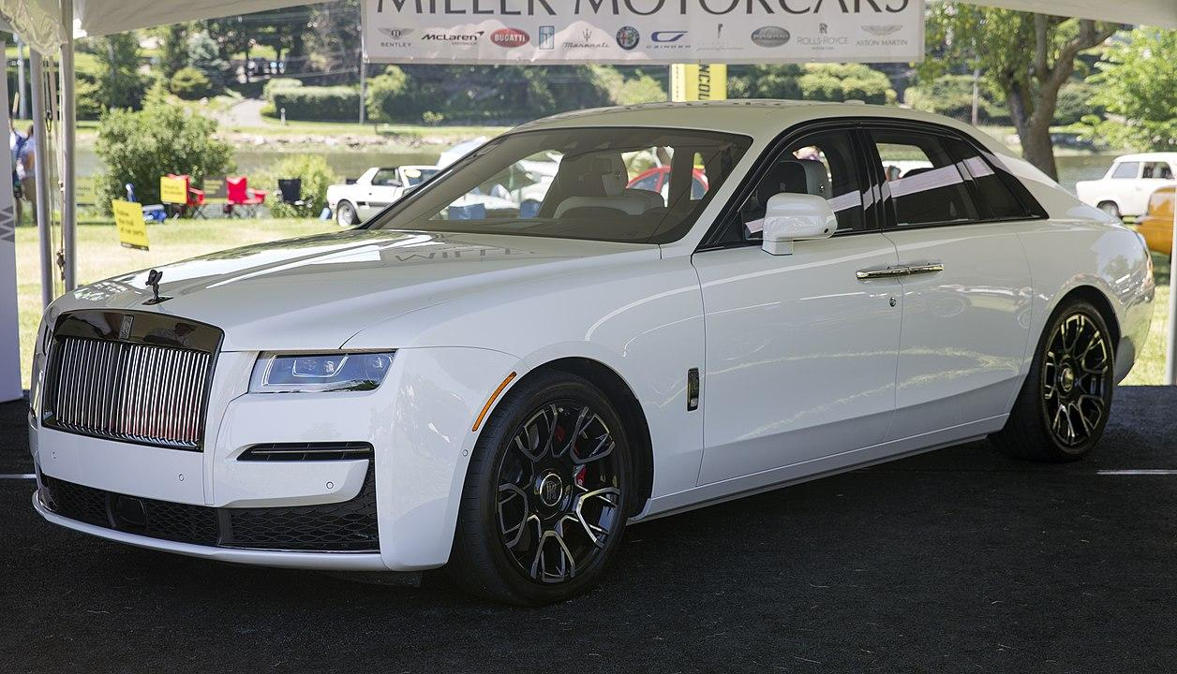
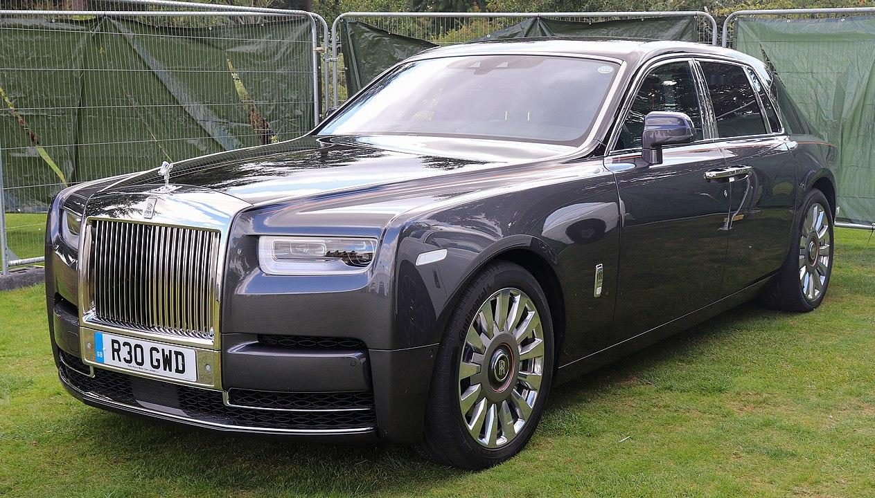
3 Most Expensive Used Cars
Ferrari 488 (2019)
Rolls-Royce Ghost (2020)
RR Phantom (2020)
Body Type | Coupe | Sedan | Sedan
Engine Type | V8 | V12 | V12
Horsepower | 711 | 563 | 563
Price | $429,900 | $450,450 | $545,150
Notes:
Meanwhile, the 3 most expensive cars are quite new (released around 2019). The body types don’t seem to differ much from the 3 cheapest cars - the only one which is different is the ferrari, which is a coupe. But, the engine type is different (1 v8 and 2 v12 compared to v6) and their horsepowers are much higher compared to the cheapest cars. So, some variables like horsepower and engine type seem to affect price while others like body type does not seem to affect much. Therefore, let’s take a closer look at some of these variables.

Slide 19
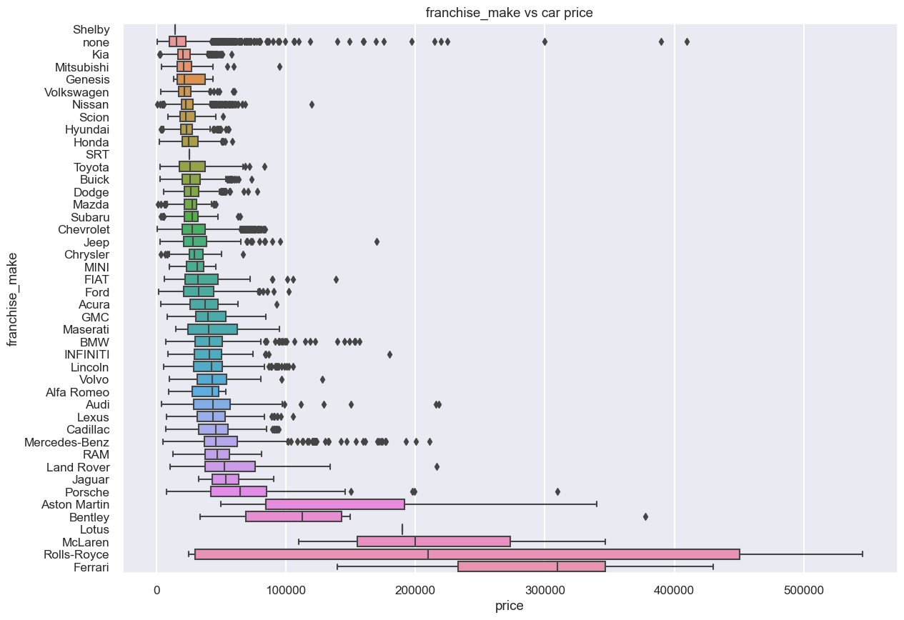
Categorical
Chevrolet | 12.1%
Ford | 10.6%
Honda | 7.0%
Jeep | 6.2%
Nissan | 5.6%
Notes:
So, from this graph, car prices for different franchises vary. For example, a car sold by Kia will have a lower price compared to a car sold by Land Rover. On the right is the distribution of the cars sold under different franchises.

Slide 20
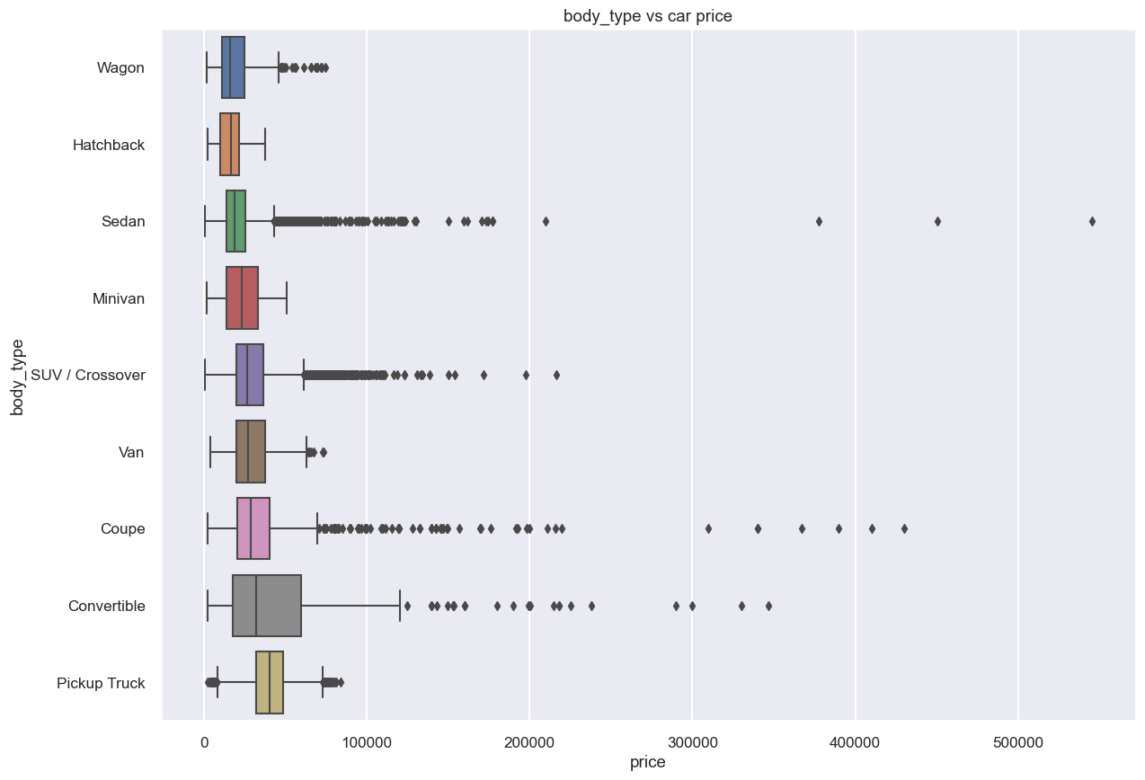
Categorical
SUV | 48.6%
Sedan | 24.3%
Truck | 15.8%
Minivan | 3.1%
Coupe | 2.6%
Notes:
From the comparison previously, we saw that the body type does not have much effect on car price and this plot shows. The median prices are relatively similar.

Slide 21
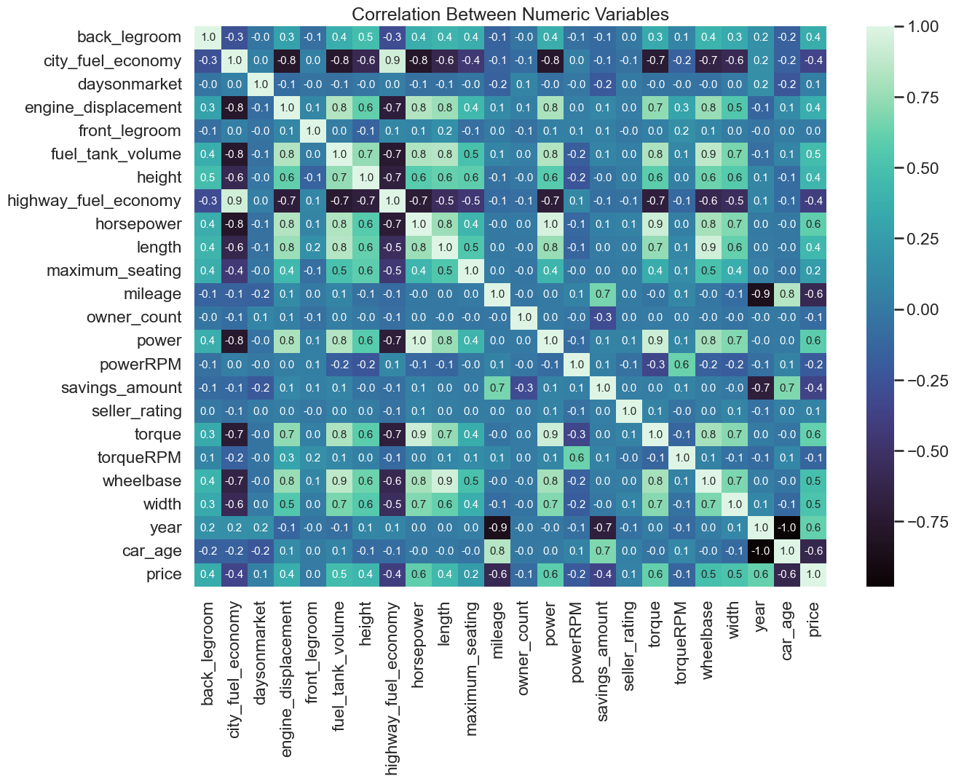
Numeric Variables
Some variables are highly correlated
Not a lot of variables have a strong correlation with price
Reduce complexity & multicollinearity with principal component analysis (PCA)
Notes:
To identify which numeric variables have a high correlation with car price, we made a correlation heatmap of all numeric variables. Although most are not strongly correlated with price, we identified some with a strong correlation like car-age, year, torque, power, mileage and horsepower. We also found that some variables are highly correlated with each other. So, to reduce the complexity of using many variables and problems that can emerge from multicollinearity, we combined some variables using principal component analysis.

Slide 22
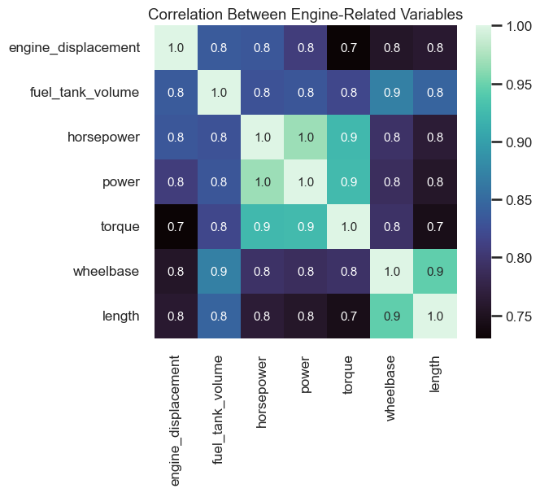
pca_engine
Wheelbase
Torque
Length
Power
Fuel tank volume
Horsepower
Engine displacement volume
Explained Variance: 0.831
Notes:
Then, we combined engine-related variables which are highly correlated with each other into 1 variable, pca_engine, using PCA. we only picked one component as it already explained most of variance from all the engine-related variables.

Slide 23
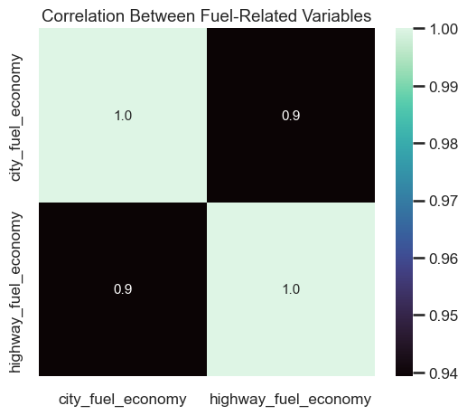
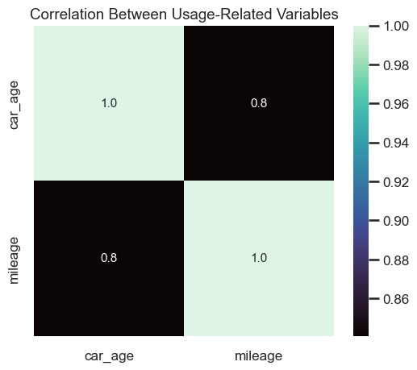
Feature Engineering
pca_fuel_economy: 0.969
pca_car_usage: 1.000
city_fuel_economy
highway_fuel_economy
car_age
mileage
Notes:
So, we combined city and highway fuel economy into one variable fuel_economy using PCA. This variable/component has a high explained variance which shows that the component represents the two variables well. We also combined car_age and mileage into one variable car_usage. This variable also represents the combined variables well.

Slide 24
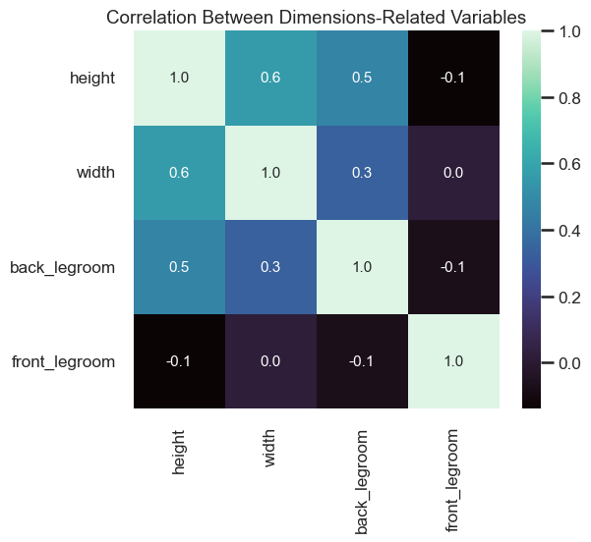
avg_car_space
Height
Width
Back Legroom
Front Legroom
Take the average of price as coefficient/weight for each variables
Use weights to determine avg_car_space during prediction
Notes:
To reduce the number of variables, we also combined car dimension-related variables into 1, avg_car_space. This was done by taking the average of car price for each variable (height, width, etc.) and using that as the coefficient/weight for each variables. The weights are only calculated during training to avoid data leakage.

Slide 25
Pipeline
Data Cleaning
Imputing
Dimensionality Reduction
Category Encoding
Feature Selection
Notes:
To simplify training, analysing and avoid data leakage in all of our data cleaning and feature engineering steps, we made a pipeline to encapsulate all the preprocessing steps. It mainly involves 5 steps: data cleaning, …

Slide 26
Data Cleaning
FeatureDropper()
Drops unused columns
TruckCreator()
Creates “isTruck” variable
CabinModifier()
Modifies “cabin” variable
IntegerConverter()
Convert discrete columns
NumericTransformer()
Strips units from columns
BoolConverter()
Converts to boolean
CategoryConverter()
Convert to category
DateConverter()
Convert to datetime64[ns]
CarAgeCreator()
Creates “car_age” variable
Notes:
The first step, data cleaning, is divided into 9 small steps, which have been explained by Aryan previously.

Slide 27
Imputing
NumericImputer()
Imputes null values in numeric columns using the mean value
BoolImputer()
Imputes null values in boolean columns using the most frequent value
Notes:
After the data is cleaned, missing/null values for numeric and boolean columns are imputed using the mean value and most frequent value. 2 exceptions are certification-related columns, which determines whether the car is sold under a certified dealer. The null value is replaced as false as there are no false values in these columns.

Slide 28
Dimensionality Reduction
FuelPCA()
Reduces 2 fuel-related variables into 1 variable
CarUsagePCA()
Reduces 2 usage-related variables into 1 variable
CarSpaceAvg()
Reduces car dimension-related variables into 1 variable
EngineScaler()
Applies min-max normalization on all engine-related columns
EnginePCA()
Reduces all normalized engine-related columns into 1 variable
Notes:
Then, highly correlated variables are combined into one as mentioned previously. We normalize the engine-related columns to maximize the variance explained by the component from PCA. The PCA estimator from sklearn and the weights for CarSpaceAvg are only fitted during training to avoid data leakage.

Slide 29
Category Encoding
Feature Selection
One-hot encode categorical variables
Combine all variables created from one-hot into 1 variable using PCA
Eliminates unused columns/variables
Selects best features based on recursive feature extraction results
Notes:
Then, the categorical columns are encoded by first applying one-hot encoding and then combining it into one variable using PCA. Finally, features to be used in the model are selected. We determined the best set of features through recursive feature extraction

Slide 30
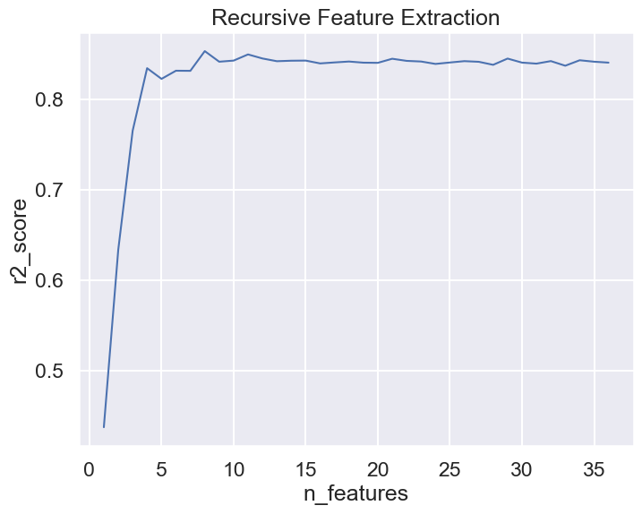

Feature Selection
Random Forest was run on sets of n features to find the best features
The best score comes with 8 features
Notes:
To select our features, we decided to train a random forest model recursively with a decreasing amount of features, and output an r2 score for each training. Starting from the maximum number of variables, we decrease the number of features selected each time, by removing the least important feature. The graph shows that when we choose the top 8 most important features, we get the best r2 score.

Slide 31








Selected Features
powerRPM
torqueRPM
pca_engine
pca_car_usage
savings_amount
franchise_make_encoded
pca_fuel
avg_car_space
Measurement of the car’s power
Measurement of the car’s torque
PCA of engine- related variables
PCA of car usage-related variables
PCA of fuel- related variables
Savings amount of each car
Weighted average of car dimensions
Company that owns the franchise
Notes:
From the recursive training, these were the 8 features that seemed to give the best r2 score with random forest. powerRPM and torqueRPM are the measurements of the car’s power and torque respectively. The savings amount describes the amount of money saved when purchasing the car, and the franchise make describes the company that owns the car franchise. The rest of the features are feature engineered ones which were described previously.

Slide 32
Model Training
Notes:
ANDREW TO SPEAK FROM HERE

Slide 33
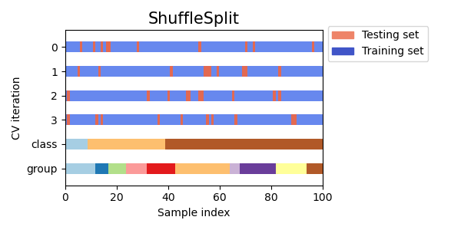
Cross Validation
Visualizing cross-validation behavior in scikit-learn — scikit-learn 1.2.2 documentation
Notes:
To prevent overfitting of our model, we used cross validation with the shuffle split method, which randomly selects a percentage of data as the testing set and the rest as the training set for each split/fold. Although shuffle split does not guarantee that all folds will be different, this is still very likely for large datasets. Next, I’ll be passing it on to Andrew to explain about the models we chose.

Slide 34


Ensemble Learning Techniques
Bagging (Random Forest)
Boosting (XGBoost)
Parallel
Sequential
D1
D2
D3

Slide 35
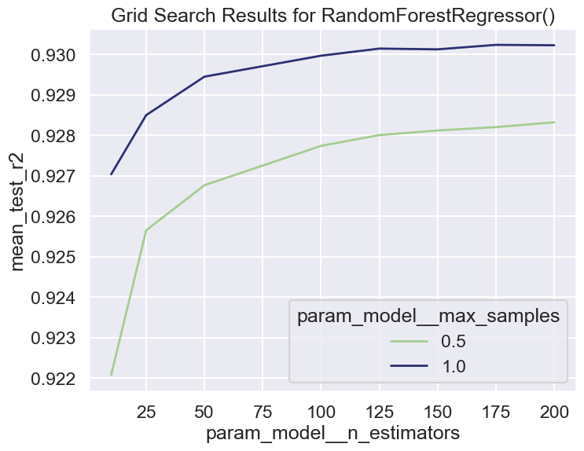
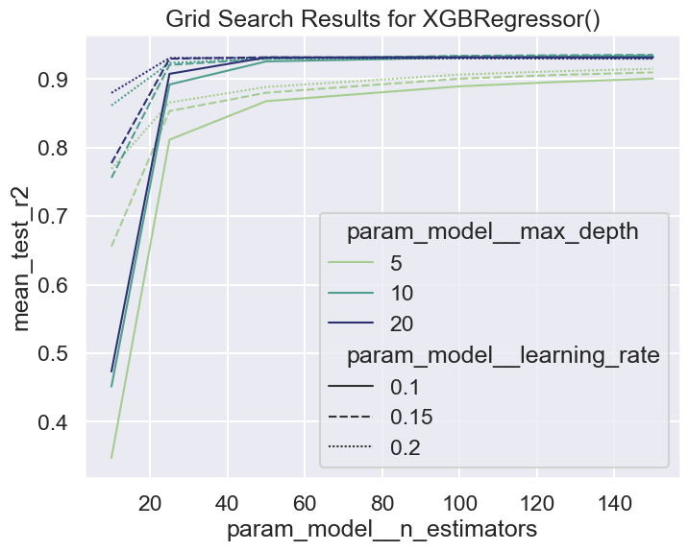
Grid Search

Slide 36
Final Results
Model/MAPE |  |  | Default |  | Grid Search
Decision tree |  |  | 13.9% |  | 13.9%
Random Forest |  |  | 11.5% |  | 11.5%
XGBoost |  |  | 12.6% |  | 11.1%

Slide 37
Data Driven Insights
Important features
Power, Torque, savings, make of the car, Engine Specifications, Car Usage, Car Space
Conclusion
Keep the information of each car to these few variables to achieve an efficient market.

Slide 38
Future Recommendations
Increase relevance to SG Market
Survey SG consumers on preferences
Choose features better
Training method
Deep Learning
Classify cars first before training
Notes:
We only used 5 of the many features in our Dataset. If Deep Learning Models are able to understand the other variables better, we could get a better accuracy. Also, sports cars which may be extremely expensive due to their limited supply may cause our training model to be confused. These two categories of cars may have very different factors that affect the price.

Slide 39
THANK YOU!

